Slide 1

2025 AI Bias Bounty Hackathon
June 28th, 2025
Hack The Fest

Slide 2

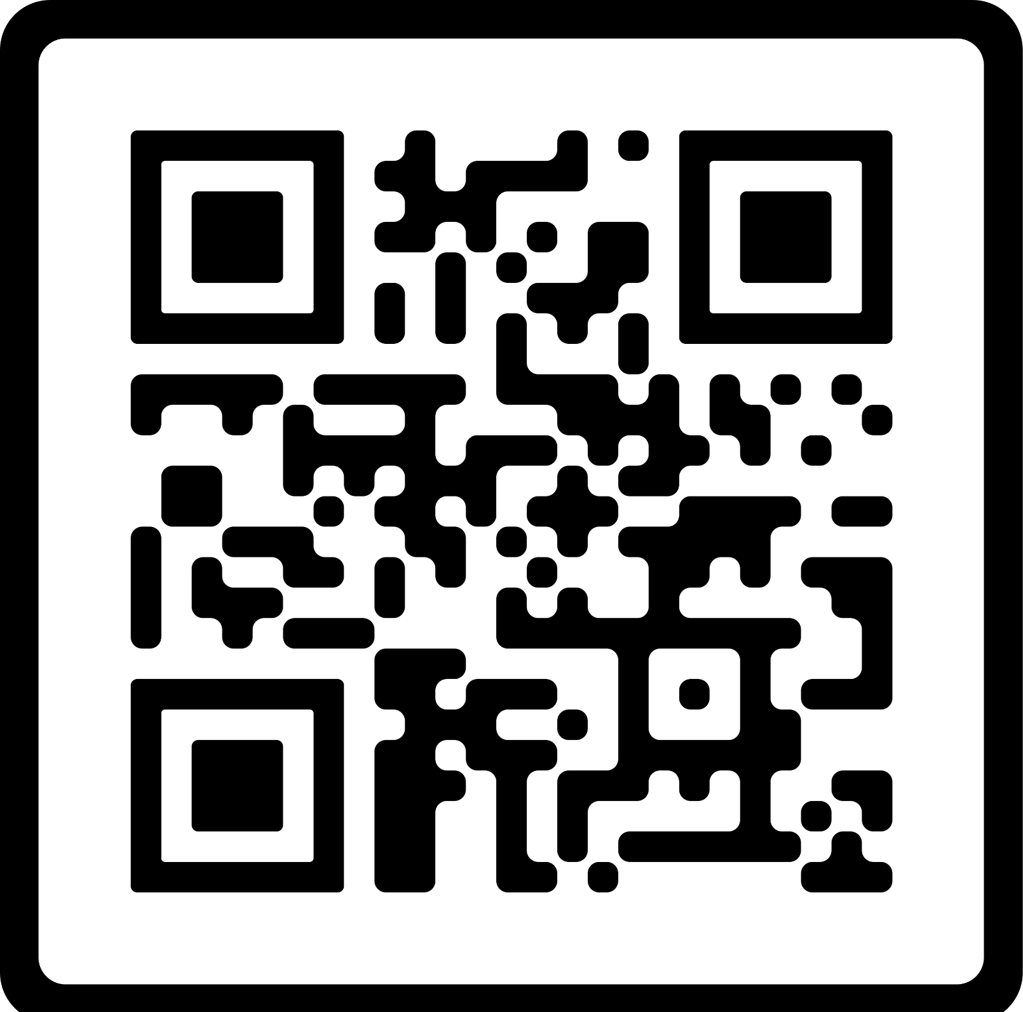

Resources

Slide 3
Table of Contents
2025 PARTICIPANTS | Page 4 | ABOUT THE DATASET | Page 15
2025 PARTICIPANTS AT A GLANCE | Page 5 | DELIVERABLES | Page 17
2025 KEYNOTE SPEAKERS | Page 6 | RUBRIC | Page 21
OVERVIEW | Page 7 | HACKATHON RULES | Page 23
KEY DATES & TIMELINE | Page 8 | AI USAGE | Page 24
TRACK DETAILS | Page 10 | PRIZES | Page 25
HOW TO GET STARTED WHAT YOU’LL BUILD | Page 12 Page 14 | FAQs | Page 26

Slide 4
2025 Participants
15+ Countries
200+ Participants
5+ Continents
Expertise: Cybersecurity, Data Science, Product Management, Software Engineering, AI Research, AI Engineering, Data Analytics, Cloud Engineering, and AI Policy.

Slide 5

















2025 Participants at a Glance

Slide 6






2025 Keynote Speakers
Anusha Dwivedula
Director of Product, Analytics
Morningstar
Arun Kumar Thankappan
VP of Product Management Cloudwick
Gowtham Chilakapti
Director Product Management
Humana
Madhu Ramanathan
Principal Group Engineering Manager, MSN, Trust, Safety and Intelligence
Microsoft
Rajesh Sura
Head of Data Engineering and Analytics, NA Stores
Amazon
Sanath Chilakala
Director, Data and AI
NTT Data

Slide 7
Overview
The AI Bias Bounty Hackathon is a 48-hour global virtual competition where participants uncover, test, and report algorithmic bias and fairness risks in AI systems, just like security researchers do with software vulnerabilities.
💡 Think of bias like a bug—one that can harm fairness and trust in AI.
🔎 Mission
The AI Bias Bounty Hackathon empowers participants to treat bias as a security risk, challenging them to actively hunt, document, and propose fixes for bias, hallucinations, and safety concerns in AI systems.

Slide 8
Key Dates & Timeline
JUN 4th—JUN 27th
JUN 28th
JUN 28th—JUN 30th
JUL 1st—JUL 3rd
Registration
Kickoff Event
Onboarding
Main Event
Sign up to secure your spot and get access to hackathon updates. Open to individuals and teams from around the world.
This is a pre-recorded keynote sessions and welcome videos from our organizers and special guests. Participants can watch the kickoff content on their own time to get prepared for the challenge ahead.
Familiarize yourself with the tools, dataset, rules and resources to prepare for the competition.
The 48-hour hackathon begins! Collaborate, analyze, and submit your findings and solutions.

Slide 9
Key Dates & Timeline^{(cont’d)}
JUL 3rd 11:59 PM^{CST}
JUL 5th—JUL 15th
JUL 17th
JUL 23rd
Submission Due
Judging Period
Winners Announced
Certificates
Final deadline to submit your project materials and demo recording.
Judges review all submissions and evaluates based on the official rubric.
Winning teams and individuals will be announced and celebrated.
Participation and award certificates will be sent to all eligible participants.

Slide 10
Track Details
What You’ll Build – Full Track Guide for Participants
TRACK NAME: Bias Detection and Fairness Modeling Using Mortgage Loan Data
Background and Context
The financial sector has long faced scrutiny over systemic inequities embedded in its decision-making processes, particularly in loan approvals. Mortgage lending, in particular, reveals deeply entrenched disparities across race, gender, age, and geography. In response to increasing demand for fairness in AI-powered decision systems, this track is designed to simulate a real-world audit scenario, where participants step into the role of ethical model builders, bias investigators, and fairness advocates.
You will be working with a dataset that mimics loan approval decisions based on real-world variables. The data is engineered to reflect patterns commonly found in U.S. lending practices, including potential biases based on protected attributes.

Slide 11
Track Details^{(cont’d)}
The Challenge Prompt
Detect and explain unusual patterns in AI decision-making for mortgage loan approvals using a provided dataset. Build a working classification model that is both accurate and fair, backed by comprehensive bias reporting and fairness-aware techniques. This is about building models that account for historical bias and uncover unusual patterns to promote responsible AI development.
What You’ll Receive
Upon onboarding, all participants will get access to:
loan_access_dataset.csv – a full labeled financial dataset for training
Train.csv - an unlabeled evaluation dataset (you must generate predictions on this)
An AI Risk Report Template (.docx + .md) for structured documentation
A scoring rubric outlining how your submission will be evaluated
Community support via Slack and onboarding walkthrough
GitHub links and additional resource library

Slide 12
How to Get Started
Your first step is to access the official [AI Bias Bounty Hackathon GitHub Repository] (link will be shared via email and Slack). This repository contains everything you need to get started, including the dataset, documentation templates, scoring rubric, and starter files.
What You'll Find in the Repository:
loan_access_dataset.csv – a synthetic dataset simulating loan approval decisions for training and exploration
Test.csv - the official test dataset for predictions (no labels)
AI_Risk_Report_Template (.docx and .md) – templates for your final fairness report
Scoring_Rubric.pdf – full judging criteria and evaluation breakdown
README.md – initial instructions and setup details

Slide 13
How to Get Started^{(cont’d)}
What You Need To Do:
Visit the GitHub link sent via email or posted in the #resources channel on Slack
Click “Fork” to create your own copy of the repository under your GitHub account
Clone your forked repository to your local machine,
Checklist to get started:
Fork the starter GitHub repo
Download all required files
Join the Slack channel for support
Set up a public repo to house all your deliverables
Save the submission form link

Slide 14
What You’ll Build
In this hackathon, you’ll be building a bias detection and fairness auditing model using machine learning. The challenge isn't just to make accurate predictions; it’s to uncover whether unfair treatment exists within the data, and if so, which groups are affected and how.
At a high level, your job is to:
Analyze a labeled loan approval dataset (loan_access_dataset.csv)
Train a classification model to predict whether someone’s loan should be approved.
Use your model to generate predictions for a new, unlabeled test set (test.csv)
Audit the model’s predictions for unusual patterns across sensitive groups (like gender, race, age, zip code, etc.).
Create visual evidence that supports your findings.
Submit your results in a structured way, including your model, output file, analysis report, and a short demo video.
NOTE: You are not required to fix or mitigate the bias, your focus is on detecting, explaining, and reporting it clearly.

Slide 15
About the Dataset
You’ll be working with two datasets called loan_access_dataset.csv(the full labeled dataset released) and test.csv(the official unlabeled test set for prediction). It simulates real-world decisions made by a fictional lending agency about whether to approve people for mortgage loans. Each row in the dataset represents an applicant and includes features like:
Gender
Race
Income
Age
Zip Code
Employment Status
Health Status
And the outcome: LoanApproved (0 = Denied, 1 = Approved)
Test.csv does not include the loanapproved column - you are expected to predict it using your trained model and submit it as submission.csv

Slide 16
About the Dataset^{(cont’d)}
Important Twist:
There are hidden biases embedded within this data. These aren’t labeled or obvious; they’re intentionally subtle, just like in real-world systems. Your model and analysis will need to investigate the data deeply to detect:
Who is being disadvantaged (e.g., gender or income)
In what ways (e.g., more denials, false positives, etc.)
Why that matters (e.g., fairness risks, systemic impact)
You’ll work with:
A labeled dataset (loan_access_dataset.csv) to train and understand outcomes
An unlabeled test dataset (test.csv) to apply your predictions and uncover how your model generalizes across different groups

Slide 17
Deliverables
At the end of the 48-hour Hackathon, every team is expected to submit a complete package of materials that reflects the depth of their work, from model development to fairness analysis, storytelling, and reproducibility. These materials will help the judging panel, made up of data scientists, AI ethics experts, and non-technical reviewers, understand both what you built and why it matters.
Your submission must include the following six components:
Public GitHub Repository (Required)
Your GitHub repo is the main hub for your work. It should contain:
loan_model.py — Python script containing
Data cleaning and preprocessing steps
Feature engineering (e.g., encoding, binning)
Model training (you may use Logistic Regression, Random Forest, XGBoost, or other classification models)
Fairness auditing and bias detection
Well-commented, readable code

Slide 18
Deliverables^{(cont’d)}
submission.csv — Your model's output on the provided test dataset
A 2-column CSV:
ID – test set identifier
LoanApproved – predicted value (0 or 1)
AI Risk Report (ai_risk_report.docx or .pdf)
Visual Evidence of Bias
Submit one or both of the following:
bias_visualization.png — a clear, readable graphic that illustrates discovered bias
Or a chart/ folder containing:
Approval rate bar plots by demographic
SHAP/LIME feature importance charts

Slide 19
Deliverables^{(cont’d)}
False positive/negative disparities
Any visual insights related to model behavior or group fairness
Label every chart clearly. These visuals will help judges understand your biased insights at a glance.
(Optional) loan_model.ipynb — Clean and reproducible Jupyter Notebook
Include EDA, model pipeline, audits, and final results
Clear markdown explanations and cell comments encouraged
README.md — Describes:
The problem you addressed
Summary of your model approach and fairness considerations
Instructions to run the project & tools/libraries used
GitHub repo should be public and well-structured

Slide 20
Deliverables^{(cont’d)}
2. Demo Video (5 Minutes Max) - Required
Create a short video walking us through:
What you built
How your model works
What biases you discovered
This doesn’t need to be perfect. Just clearly show your process and thinking. You may use Loom, Zoom, OBS, or any screen recorder. Upload to YouTube (unlisted), Google Drive, or a public link and include it in your README.
3. Submission Form Link
After completing your GitHub repo, you must submit the repository link using the official Final Submission Form. This is how your entry is registered for judging.

Slide 21
Our judging panel is made up of industry leaders, data scientists, AI ethics professionals, and engineers across tech firms like Meta, Google, Amazon, Visa, JPMorgan, and Walmart, who will evaluate your work based on the following key areas. Each area reflects both the technical quality of your work and your ability to think critically about fairness, impact, and communication.
Rubric

Slide 22
Rubric^{(cont’d)}
Bias Identification (30 pts)
Model Design & Justification (30 pts)
We’re looking for how well you detected and explained patterns of bias in the dataset or model predictions.
Strong entries will show clear evidence of bias across multiple demographic groups (e.g., gender, race, income) and thoughtfully discuss false positives/negatives and their real-world implications.
Your model doesn’t need to be perfect, but your choices should be intentional. This includes the algorithms you used, the features you engineered, and how you approached fairness. We value models that are interpretable and grounded in thoughtful design, not just performance.
Interpretability & Insights (20 pts)
Presentation & Clarity (20 pts)
Judges will be looking at how well you explain your results.
Use charts, plots, tools like SHAP/LIME, or group breakdowns to show what’s happening inside your model, especially when it behaves unfairly.
Clear communication is key. Your README, demo video, and any supporting materials should help others understand your work without confusion. The best submissions will be organized, polished, and easy to follow, even for non-technical reviewers.

Slide 23
Hackathon Rules
All participants must adhere to these rules to ensure fairness, safety, and integrity throughout the competition. Any violations, including but not limited to using private or confidential data, plagiarizing content, or submitting work that is not original, will result in immediate disqualification from the competition.
Prohibited Content and Data Usage:
Participants are strictly prohibited from using confidential, proprietary, or private datasets not explicitly provided or approved for the competition.
Creation, submission, or presentation of harmful, illegal, discriminatory, or offensive content is forbidden.
Plagiarism in any form, including copying code, analyses, or methodologies without proper attribution, is grounds for disqualification.
All work must comply with the terms of service of any third-party models, datasets, or platforms utilized.
Original work is required; when building upon existing methodologies or code, proper citations and acknowledgments must be provided.
NOTE: HackTheFest organizers reserve the right to modify competition rules as necessary to maintain fairness and safety, with timely notification provided to all participants.

Slide 24
AI Usage
AI tools are welcome to assist with development, research, and technical implementation throughout the hackathon. However, AI-generated content is prohibited in final project pitches and demonstrations. All presentations must be created and delivered by team members or individuals without AI assistance.
Participants are solely responsible for the accuracy of their bias assessments, the validity of their methodologies, and the integrity of their findings. You must be able to defend your analysis techniques and explain the rationale behind your approach without relying on AI-generated explanations.
NOTE: HackTheFest reserves the right to modify these AI usage rules as necessary to maintain fair competition standards. Participants will be notified of any rule changes promptly.

Slide 25
Prizes
1st Winner
2nd Winner
$1000 Azure OpenAI Credits
$100 Gift Card
Certificate
$600 Azure OpenAI Credits
$50 Gift Card
Certificate
3rd Winner
All Participants
$400 Azure OpenAI Credits
Certificate
Certificate of Recognition

Slide 26
FAQs
1. When does the hackathon start and end?
The hackathon officially begins on Tuesday, July 1, 2025, and ends on Wednesday, July 3, 2025, at 11:59 PM CT. You’ll have 48 hours to explore the data, build your model, and submit your deliverables.
2. How do I access the dataset?
The dataset will be released on Monday, June 30, 2025 via Slack, DevPost and email. Please check the #announcements channel and your inbox for the download link.
3. Do I need a team to participate?
No, you can participate solo or as part of a team (maximum of 4 people). If you haven’t formed a team yet, you can still do so before the hackathon begins. Use the DevPost or Slack channel to connect with others.
4. What are we expected to submit?
You’ll submit a public GitHub repo with:
submission.csv (model predictions output)
loan_model.py – your model code

Slide 27
FAQs
bias_visualization.png or charts
README.md (project overview)
ai_risk_report.pdf/.docx (bias audit)
5-minute demo video (YouTube or Drive link)
More details are outlined in the "Deliverables" section of the onboarding packet.
5. Where do I submit my final project?
You’ll receive a Final Submission Form link with the dataset. There, you’ll paste your GitHub repo link and demo video.
6. What tools or programming languages can I use?
Python is recommended. You may use any libraries such as scikit-learn, XGBoost, pandas, Fairlearn, SHAP, etc. Your submission should be in .py files.
7. Can I use external datasets or pre-trained models?
Only the dataset provided for the competition should be used for training. You may use public pre-trained models for feature extraction or bias testing if clearly explained in your README and Demo Video.

Slide 28
FAQs
8. How will judging work?
Submissions will be evaluated on:
Bias identification and fairness analysis
Model design and justification
Interpretability and insight
Clarity of documentation and presentation
Judges are a mix of data scientists, AI ethicists, and technical leaders from top companies.
9. Is there a prize?
Yes! Participants stand a chance to win up to $1000 in prizes, along with certificates, special mentions with industry experts from Google, Meta, and more.
10. What if I have questions or need help?
Join the conversation in our Slack workspace, especially the #questions channel. Organizers will be available to help throughout the hackathon.

Slide 29
Questions?
Leave it on the Slack channel #questions or send us an email at support@hackthefest.com

Slide 30
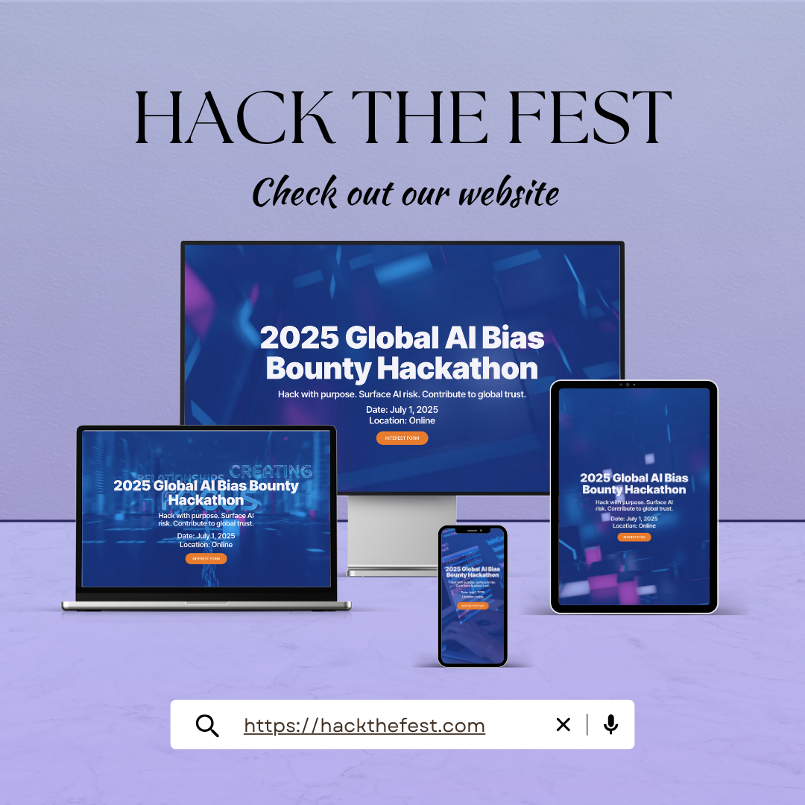
Thank You!!!

